Slide 1


Department of Electronics and Communication Engineering
A Major Project
on
“Python Programming for Efficient Breathomics Image Processing and Analysis”
Presented by: (Batch:A1)
G. Sharanya
K. Srilekha
B. Namratha
Ch. Shreeja
Guide:
Dr.T.Anil Kumar
Professor and Principal
D.Ravikiran Babu
Associate Professor

Slide 2
Table of Contents
Abstract
Introduction
Problem Statement
Aim and Objectives
Scope & Motivation
Proposed System
Requirements
Block diagram
Algorithms
Dataset
Results
Conclusion
References

Slide 3
Abstract:
This project presents an approach utilizing both traditional machine learning (ML) and deep learning (DL) models to classify human breathing patterns—normal, shallow, and deep—through image-based analysis of breath condensation on cold surfaces.
Traditional ML models were trained using statistical features such as mean intensity, texture variation, and condensation area.
A series of deep learning models—including a custom Convolutional Neural Network (CNN) and state-of-the-art transfer learning architectures like MobileNetV2, InceptionV3, ResNet50, and EfficientNetB0—were trained on raw image data.
This project highlights the potential of image-based breathomics for scalable, contactless respiratory monitoring applications in clinical and home settings.

Slide 4
Introduction:
The field of breathomics aims to use the information of VoCs for non-invasive diagnostics and continuous health monitoring.
Recent research has introduced visual breath analysis as an alternative, wherein breath condensation patterns formed on cold surfaces are captured and analysed.
Unlike chemical sensors, this method is non-contact, cost-effective, and potentially deployable in everyday environments.
The ML and DL models are evaluated under various conditions, including increased data complexity and real-world noise, to test their robustness and adaptability.

Slide 5
Problem Statement:
Traditional breath analysis methodsareoften expensive, time-consuming, and require specialized equipment, making them inaccessible for real-time and home-based respiratory health monitoring.
This project proposes an image-based breathomics system using ML & DL and image processing techniques to detect, track, and analyze breath condensation patterns.
By extracting key features such as breath spread, condensation intensity, and inhalation-exhalation cycles, the system aims to provide a simple, low-cost, and effective solution for respiratory health monitoring without requiring IoT connectivity.

Slide 6
Aim and Objectives:
To design and implement an AI based diagnostic system using breathomics image data for accurate classification and early detection of lung diseases.
To implement and compare multiple deep learning models & machine learning models.
To analyze model performance under progressive data inclusion by training and testing with varying proportions .
To evaluate the system’s performance.
To build a scalable and interpretable pipeline for potential real-world deployment in early detection of lung diseases.

Slide 7




Scope:
Motivation:
This project focuses on analyzing breathing patterns using image processing and algorithms to detect and classify breath-based biomarkers. It aims to develop a non-invasive, low-cost, and real-time diagnostic tool by studying breath condensation patterns and respiration dynamics.
Advancements in ImageProcessing
Early detection of health problems
Proactive healthcare interventions
Growing Need for Non-Invasive Diagnostics.

Slide 8
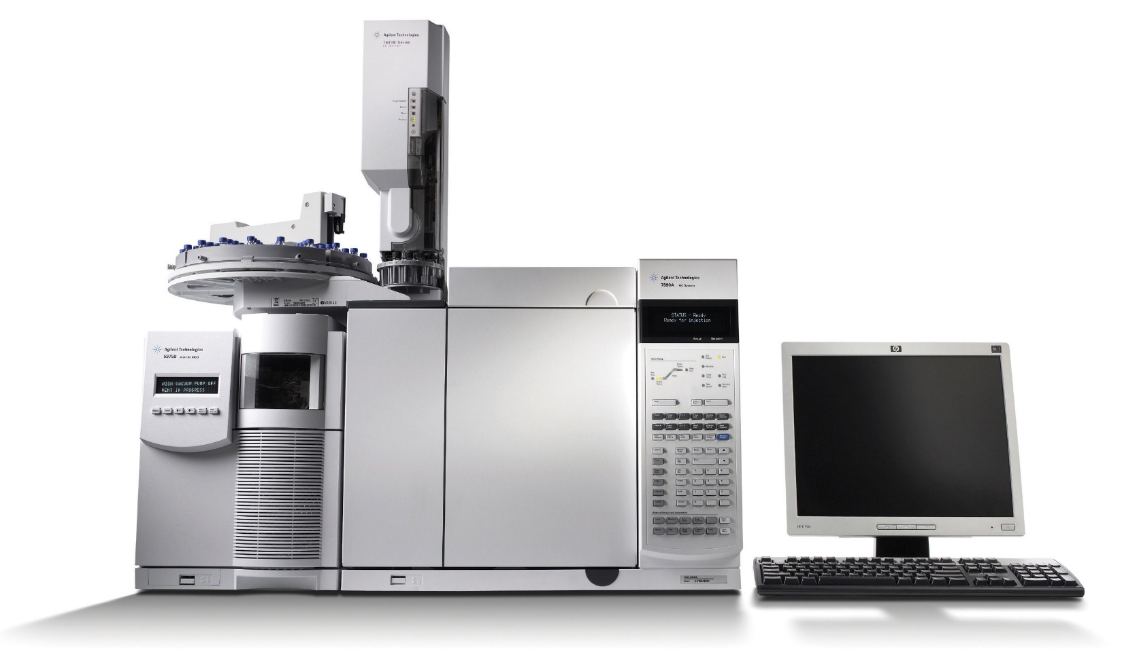
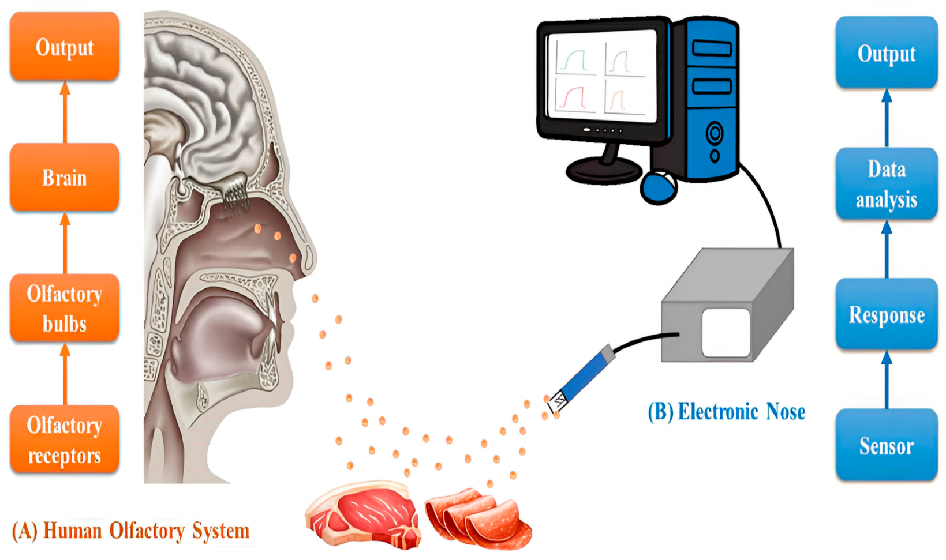
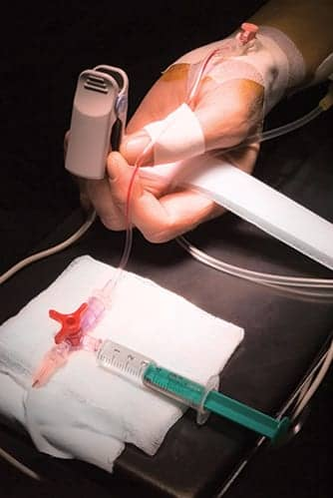
Existing System:
Currently, breath analysis is performed using:
Gas Chromatography-MassSpectrometry (GC-MS).
ElectronicNose (E-Nose)Technology.
Spirometry & Pulse Oximetry.
Limitations:
Invasive orSemi-Invasive.
Expensive Equipment.
NotReal-Time.

Slide 9

Proposed Method:
Proposed System: AI-Based breathomics Using Image Processing
Image-Based Breath Analysis.
ML & DL based Model.
Real-Time & Non-Invasive Monitoring.
Low-Cost & Accessible Solution.

Slide 10
Specifications Used:
Hardware Requirements:
Computer/Laptop
Minimum 8GB RAM (16GB recommended)
Intel i5/i7 processor
SSD storage with at least 50GB free space
Software Requirements:
Programming Environment
Python 3.11
Jupyter Notebook / (VS Code)
OS : Windows 10/11,
2. Libraries and Frameworks
Deep Learning: TensorFlow, Keras
Data Handling: NumPy, Pandas
Image Processing: OpenCV
Visualization: Matplotlib, Seaborn
Machine Learning & Evaluation: Scikit-learn.

Slide 11
Algorithms:
Machine Learning:
Support Vector Machine (SVM)
Random Forest
Logistic Regression
Decision Tree
K-Nearest Neighbors (KNN)
Deep Learning:
Custom CNN: Built from scratch with
convolution, pooling, and dense layers.
InceptionV3
DenseNet121
VGG16

Slide 12
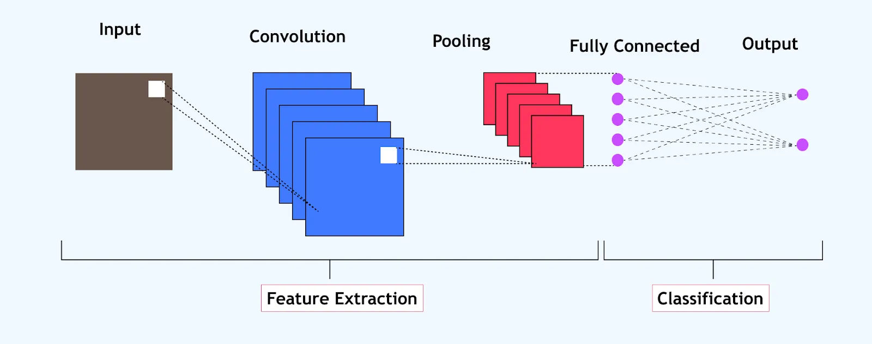
Custom CNN:
The model was trained for multiple epochs, with early stopping and model checkpointing integrated to prevent overfitting and retain the best performing weights.
This custom CNN architecture proved to be robust across multiple trials, offering high accuracy and generalization on unseen data.

Slide 13
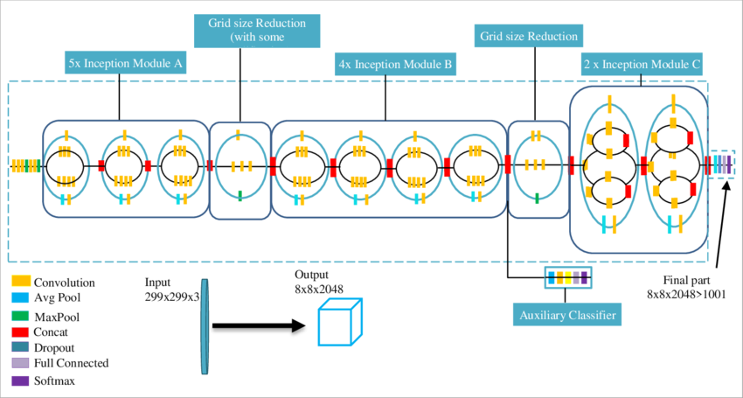
InceptionV3:
InceptionV3 is a deep convolutional neural network architecture that builds on the success of the original GoogleNet (Inception V1).
It introduces several refinements to increase computational efficiency and representational power.

Slide 14
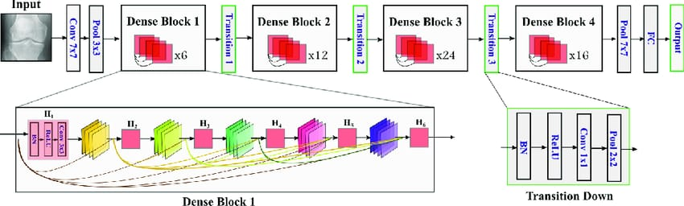
Densenet121:
DenseNet121 is a deep learning model that connects each layer to every other layer in a feed-forward fashion.
For each layer, the feature maps of all preceding layers are used as inputs, and its own feature maps are used as inputs for all subsequent layers.

Slide 15
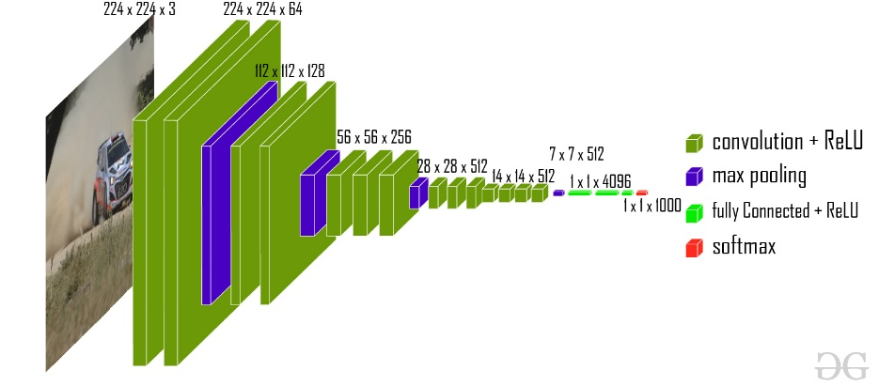
VGG16:
VGG16 stands Visual Geometry Group.
The "16" in VGG16 refers to the total number of trainable layers in the network.
It consist of 16 weight layers, including 13 convolutional layers followed by 3 fully connected layers.

Slide 16
Work Flow :
Start
Collect breath pattern images
Label images
Choose approach
Traditional ML
Deep Learning
Extract features
Prepare raw images
Train & Evaluate
Train & Evaluate
Compare performance
Select best model
Deploy model
Stop

Slide 17
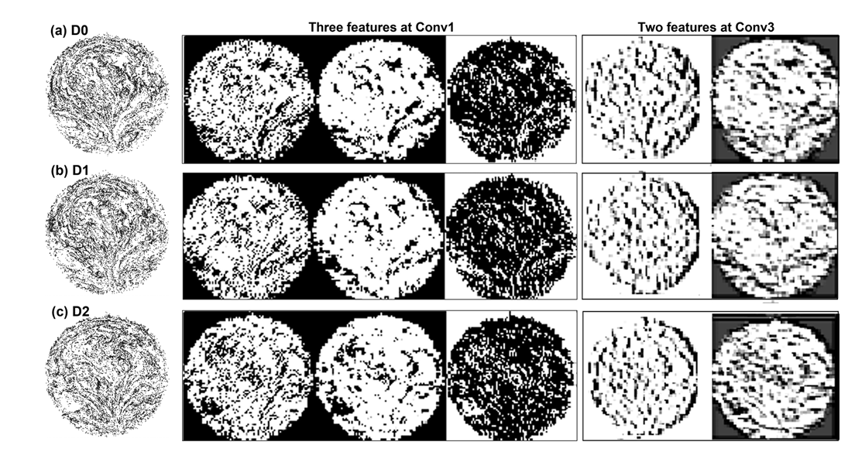
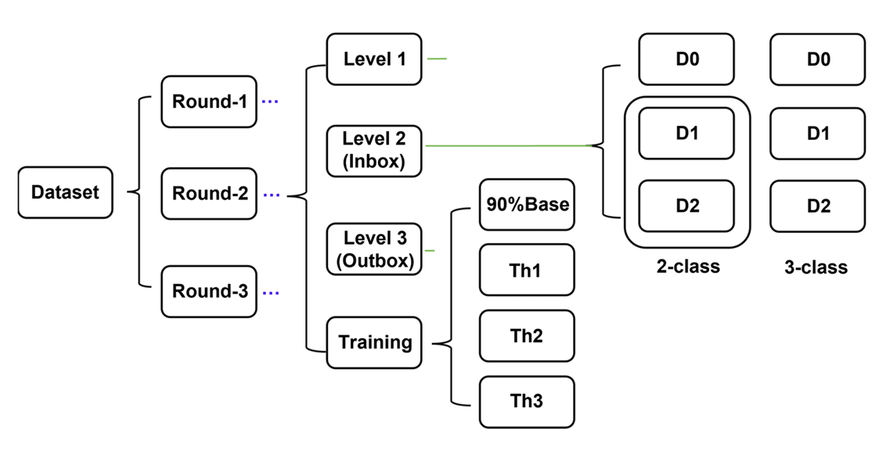
Dataset:
Fig : Sample Breathomics dataset
Fig: Block diagram of Dataset

Slide 18
Results:
To enable traditional ML algorithms and to process the image data, statistical features were extracted from each image:
Mean Intensity
Standard Deviation
White Pixel Count
All images were resized to a fixed dimension (128×128 pixels) and converted to grayscale for uniform processing.
The extracted features were normalized and formatted into a tabular structure to train classifiers.

Slide 19
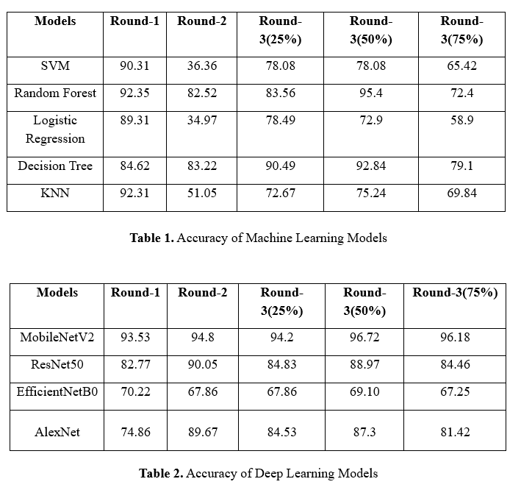
Accuracy of Machine Learning and Deep Learning Models:

Slide 20
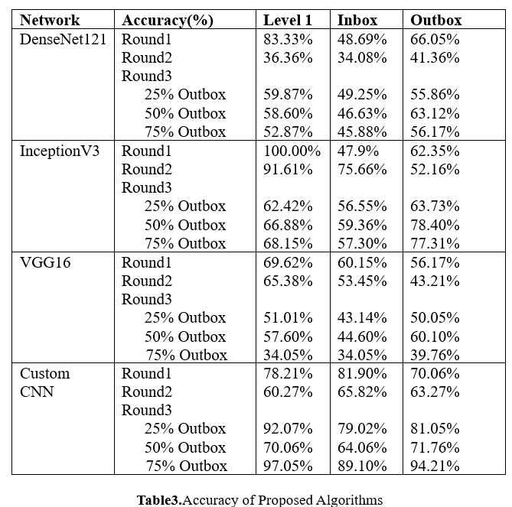
Accuracy of Proposed Algorithms:

Slide 21
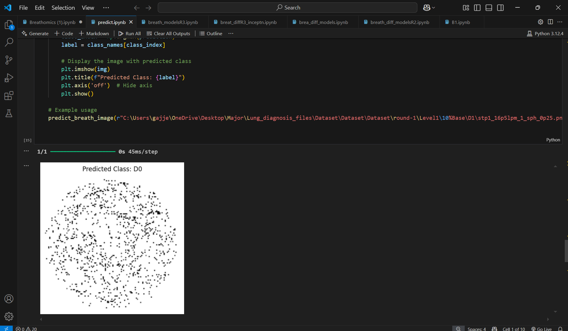
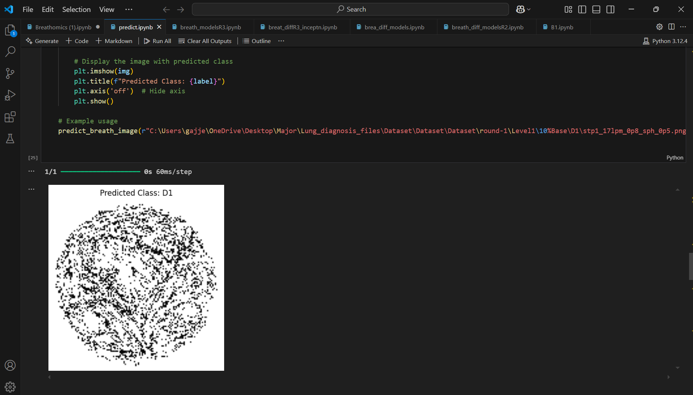
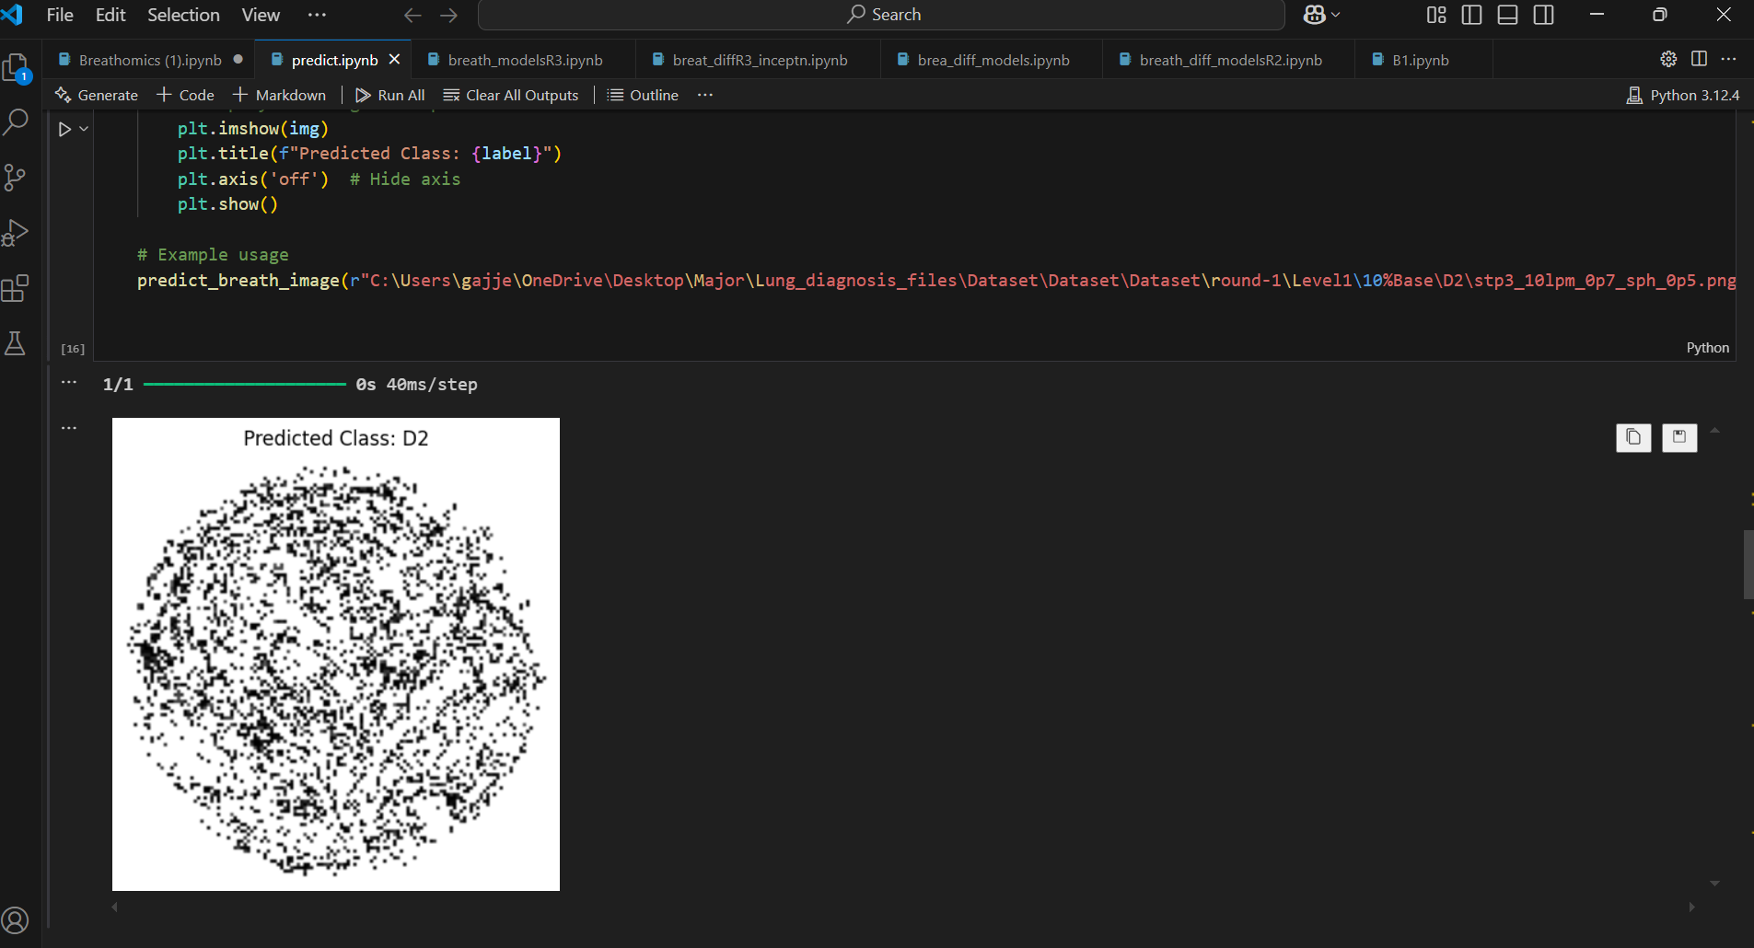
Figure: Breathomics image predictions using the trained model — (a) D0: Healthy, (b) D1: Mild condition, (c) D2: Severe condition. The model effectively distinguishes different stages of respiratory health.
Fig (a)
Fig (b)
Fig (c)

Slide 22
Conclusion :
The project demonstrates the effectiveness of deep learning in classifying respiratory conditions from breathomics images. While traditional models like Random Forest performed well, deep learning models, especially InceptionV3, showed superior accuracy and generalization. Among all, InceptionV3 achieved the best performance in Outbox data with 78.40% accuracy, making it the most efficient model for real-world applications. This highlights the potential of AI-based, non-invasive diagnostics for early lung disease detection.

Slide 23
References:
[1] AndrésArcentales, Beatriz F.Giraldo, Member, IEEE, PereCaminal,IvánDiaz, Salvador Benito “Spectral Analysis of the RR series and the Respiratory Flow Signal on Patients in Weaning Process ” 32nd Annual International Conference of the IEEE EMBS Buenos Aires, Argentina, August 31 - September 4, 2010.
[2] PerenaGouma,KrithikaKalyanasundaram, Xiao Yun, Student Member, IEEE,MilutinStanac´evic´, Member, IEEE, andLishengWang “Nanosensorand BreathAnalyzerfor Ammonia Detection in Exhaled Human Breath” IEEE SENSORS JOURNAL, VOL. 10, NO. 1, JANUARY 2010.
[3] SatoruMomose, KazuakiKarasawa,MichioUshigome,RyozoTakasuand OsamuTsuboiDevices & Materials Laboratory, Fujitsu Laboratories Limited, 10-1Morinosato-Wakamiya, Atsugi 243-0197,Japan.“HighlySelective and Sensitive Gas Sensors for Exhaled Breath Analysis usingCuBrThin Film” Proceedings of the 11th IEEE Annual International Conference on Nano/Micro Engineered and Molecular Systems (NEMS) Matsushima Bay and Sendai MEMS City, Japan, 17-20 April, 2016.

Slide 24
[4] Abel Torres, Member, IEEE, LeonardoSarlabous, José A.Fiz, JoaquimGea, Juana M.Martínez-Llorens, J.MoreraandRaimonJané, Member, IEEE “NoninvasiveMeasurement of Inspiratory Muscle Performance by means of Diaphragm MuscleMechanomyographicSignals in COPD patients during an Incremental Load Respiratory Test” 32nd Annual International Conference of the IEEE EMBS Buenos Aires, Argentina, August 31 - September 4, 2010.
[5] FrancescoVicario* , Antonio Albanese, NikolaosKaramolegkos, Dong Wang¸ AdamSeiver, and Nicolas W.Chbat, Members, IEEE “NoninvasiveEstimation of Respiratory Mechanics in Spontaneously Breathing Ventilated Patients: A Constrained Optimization Approach”.
[6] M. Li1 , S. Biswas2 , M. H. Nantz2 , R. M. Higashi2,3,4 and X. A. Fu*1 1Deapartmentof Chemical Engineering, 2 Department of Chemistry, 3Centerfor Regulatory and Environmental Analytical Metabolomics (CREAM), and 4 James Graham Brown CancerCenterUniversity of Louisville, Kentucky, USA“AMicrofabricatedPreconcentratingDevice For Exhaled Breath Analysis”.

Slide 25
[7] MonitaWahengbam, M.Sriram,TonjamGunendraSingh “Deep Learning-based Early Lung Cancer Detection using Multi-Model Image Fusion Technique” 2023 2nd International Conference on Automation, Computing and Renewable Systems (ICACRS).
[8] SayyadaHajeraBegum, MirzaIliyazBaig, Mohammed Abbas Hussain,Mohd. AbdulMuqeet“A Lightweight Deep Learning Model for Automatic Diagnosis of Lung Cancer” 2022 IEEE 2nd International Conference on Mobile Networks and Wireless Communications (ICMNWC).
[9] YuxuanTian “Lung Function Decline Predicting Using ImprovedEfficientNet” 2022 7th International Conference on Intelligent Computing and Signal Processing (ICSP).
[10] NajiKhosravan,UlasBagci, University of Central Florida, Orlando, FL, USK “Semi-Supervised Multi Task Learning for Lung Cancer Diagnosis” 2018 40th Annual International Conference of the IEEE Engineering in Medicine and Biology Society (EMBC).
https://www.researchgate.net
https://www.geeksforgeeks.org/deep-learning-tutorial/

Slide 26
Thank You !

